Slide 1




Traffic Sign Detection
Name:-Krishna Patel
Enrollment No. :-21002170110108
Branch:-CE
Roll No. :-43

Slide 2
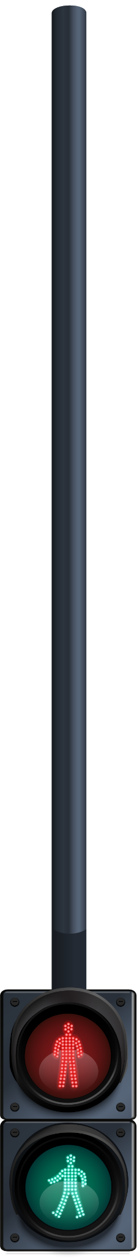

Table of contents
01
02
03
Abstract
Objective
04
Scope
About Code
05
06
Future
Conclusion

Slide 3
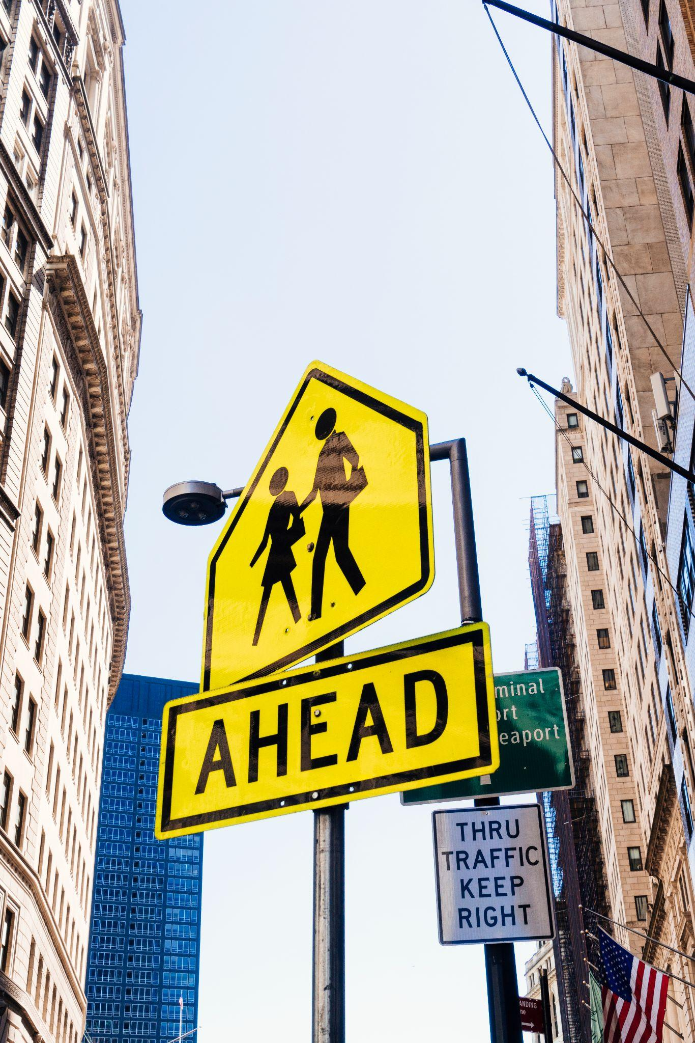

Abstract
01
Traffic signs play a crucial role in managing traffic on the road, disciplining the drivers, thereby preventing injury, property damage, and fatalities. Traffic sign management with automatic detection and recognition is very much part of any Intelligent Transportation System (ITS).
Traffic sign detection using TensorFlow, Keras, and OpenCV involves leveraging convolutional neural networks (CNNs) to identify and classify traffic signs from images. The key technologies employed in the development of this project include:
Tensorflow & Keras
Numpy
Pandas
Matplotlib
OpenCV

Slide 4
02
Objective
In this era of self-driving vehicles, calls for automatic detection and recognition of traffic signs cannot be overstated. This ppt presents a deep-learning-based autonomous scheme for cognizance of traffic signs in India.
The automatic traffic sign detection and recognition was conceived on a Convolutional Neural Network (CNN)
based end-to-end learning.
The prime objective of this project is to identify measures that minimize traffic accident.

Slide 5
03
Scope
Traffic sign detection systems can be integrated into traffic management systems and infrastructure to monitor traffic flow, enforce regulations, and optimize traffic control strategies.
They provide valuable data for traffic analysis, planning, and optimization, helping authorities manage congestion, reduce accidents, and improve overall traffic efficiency.
Traffic sign detection systems can be used for educational purposes to raise awareness about traffic regulations, signs, and safe driving practices.

Slide 6
04
About Code
I have used INDIAN TRAFFIC SIGN DATASET, an extensive collection of Traffic Sign images. It consists of 13,971 total images labeled with 59 classes
By splitting the dataset and visualizing it, you can gain a better understanding of the dataset's characteristics, identify potential challenges for traffic sign detection algorithms, and ensure the quality and representativeness of the training, validation, and test sets.
The CNN model architecture used for traffic sign detection consists of convolutional layers for feature extraction, max-pooling layers for dimensionality reduction, and ReLU activation functions to learn complex patterns. Dropout layers mitigate overfitting, while fully connected layers with ReLU activation perform classification.
The model is compiled with sparse categorical cross-entropy loss, Adam optimizer, and accuracy metric for evaluation. The final dense output layer with softmax activation produces probability distributions over different traffic sign classes.

Slide 7
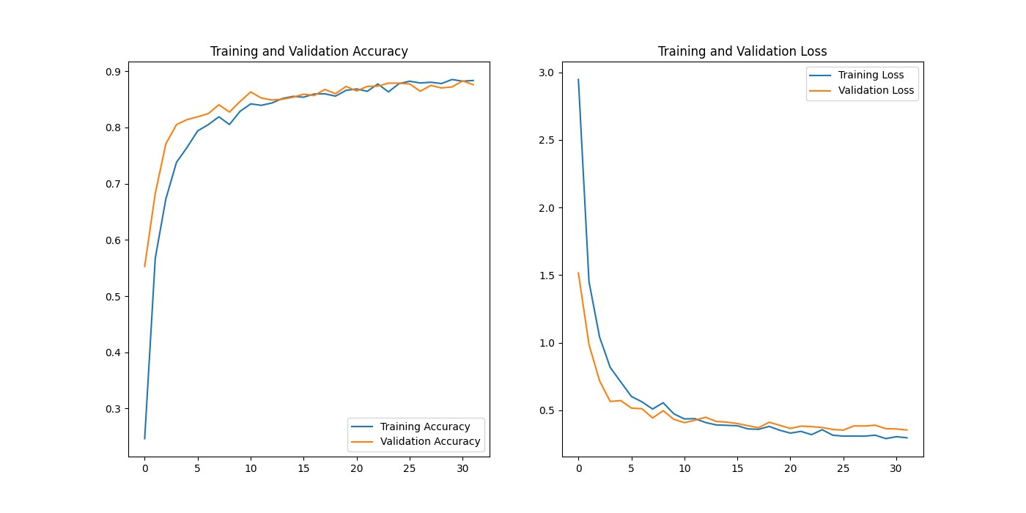
Evaluation of the model

Slide 8
05
Future
Advanced Model Architectures
Explore ResNet, Inception, or EfficientNet for improved detection accuracy.
Real-time Processing
Integrate into a real-time pipeline for faster inference in autonomous driving.
Integration with GPS and
Sensor Data
Combine with GPS and sensors for enhanced contextual understanding.

Slide 9
06
Conclusion
Our project centers on Traffic Sign Detection using Deep Learning to enhance safety and efficiency in traffic monitoring and surveillance applications.
Project Focus
Model Development
Leveraging Python, OpenCV, and TensorFlow/Keras, we developed a robust system capable of accurately detecting traffic signs within images. By fine-tuning CNN models and integrating data augmentation techniques, we achieved high accuracy levels and improved generalization capabilities.

Slide 10


Thanks

Slide 11
References
https://www.analyticsvidhya.com/blog/2021/12/traffic-signs-recognition-using-cnn-and-keras-in-python/
https://www.sciencedirect.com/science/article/pii/S2046043022000557
https://youtu.be/eS8sE1M9dks?si=NXB5dDTbw6pNSQ9B
https://youtu.be/qahpZkPlTRM?si=HlUrADffeSwMHoVB

